Slide 1

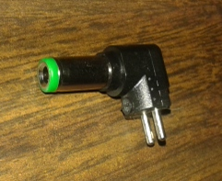
DC 9 – 12V IN
+
-
OUTPUT –
OUTPUT +
INPUT +
INPUT –
Note:
Interchange INPUT + and – → OUTPUT = Interchanged

